Slide 1
Plagiarism
A Plague Among Students

Slide 2
Do Now: For Discussion
How would you define plagiarism?

Slide 3
Definition
An act or instance of using or closely imitating the language and thoughts of another author without authorization and the representation of that author's work as one's own, as by not crediting the original author.
Definition is from dictionary.com

Slide 4
Let’s examine how two major universities describe and handle cases of plagiarism.

Slide 5
Example #1
National Park Summary
Student Work
The Battle of Greenbrier River was on October 2nd - 3rd , 1861 . Union General Joseph Reynolds with two brigades advanced from Cheat Mountain to reconnoiter the Confederate position at Camp Bartow on the Greenbrier River. Reynolds drove in the Confederate pickets and opened fire with his artillery. After sporadic fighting and an abortive attempt to turn his enemy’s right flank, Reynolds withdrew to Cheat Mountain. There were 82 casualties from the 6,800 engaged
The Battle of Greenbrier River was on October 2nd - 3rd , 1861 . Union General Joseph Reynolds with two brigades advanced from Cheat Mountain to reconnoiter the Confederate position at Camp Bartow on the Greenbrier River. Reynolds drove in the Confederate pickets and opened fire with his artillery. After sporadic fighting and an abortive attempt to turn his enemy’s right flank, Reynolds withdrew to Cheat Mountain. There were 82 casualties from the 6,800 engaged

Slide 6
National Park Service Summary
The Battle of Greenbrier River was on October 2nd - 3rd , 1861 . Union General Joseph Reynolds with two brigades advanced from Cheat Mountain to reconnoiter the Confederate position at Camp Bartow on the Greenbrier River. Reynolds drove in the Confederate pickets and opened fire with his artillery. After sporadic fighting and an abortive attempt to turn his enemy’s right flank, Reynolds withdrew to Cheat Mountain. There were 82 casualties from the 6,800 engaged.
How could you summarize the information so it is not plagiarized?

Slide 7
Example #2
biography.com
Student work
But while Mary and the children spent their lives on Mary's father's plantation, Lee stayed committed to his military obligations. His Army loyalties moved him around the country, from Savannah to Baltimore, St. Louis to New York
But while Mary and the children spent their lives on Mary's father's plantation, Lee stayed committed to his military obligations. His Army loyalties moved him around the country, from Savannah to Baltimore, St. Louis to New York.

Slide 8
How can we change example #2
How could you summarize the information so it is not plagiarized?
What else could you do to “legalize” using this part of the website’s written work?

Slide 9
Example #3
Civil War Trust
When the Civil War ended Thomas led the department of the Cumberland in Tennessee and Kentucky. Thomas then protected freedmen from the abuses from whites in the area. Military commissions were set by him to enforce any labor contracts because the courts in the area had stopped operating or had biases against blacks.
Student work
When the Civil War ended Thomas led the department of the Cumberland in Tennessee and Kentucky. Thomas then protected freedmen from the abuses from whites in the area. Military commissions were set by him to enforce any labor contracts because the courts in the area had stopped operating or had biases against blacks.

Slide 10
Academic Dishonesty
Not only is plagiarism illegal, it is also a part of a larger issue called academic dishonesty.
What is academic dishonesty?
“Academic dishonesty or academic misconduct is any type of cheating that occurs in relation to a formal academic exercise.”
What does it include?

Slide 11
Types of academic dishonesty
Plagiarism: The adoption or reproduction of ideas or words or statements of another person without due acknowledgment.
Fabrication: The falsification of data, information, or citations in any formal academic exercise.
Deception: Providing false information to an instructor concerning a formal academic exercise—e.g., giving a false excuse for missing a deadline or falsely claiming to have submitted work.
Cheating: Any attempt to give or obtain assistance in a formal academic exercise (like an examination) without due acknowledgment.
Sabotage: Acting to prevent others from completing their work. This includes cutting pages out of library books or willfully disrupting the experiments of others.
Academic dishonesty has been documented in most every type of educational setting, from elementary school to graduate school.
As found in http://www.berkeleycitycollege.edu/wp/de/what-is-academic-dishonesty/

Slide 12
Academic Dishonesty
Basically it is commonly referred to as cheating.
Give me some examples:

Slide 13
Academic Dishonesty
Sharing homework: probably one of the most common forms of cheating. Unless you are doing a group assignment, allowing your friends to copy your work is dishonest, both for them and you.

Slide 14
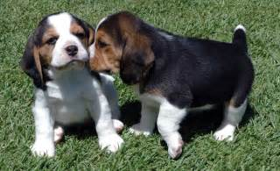
Academic Dishonesty
Sharing test answers: a good way to fail the test for both you and the person you are talking to. You could be the best students in the class, or the cutest, but if you are giving other students the answers . . .

Slide 15
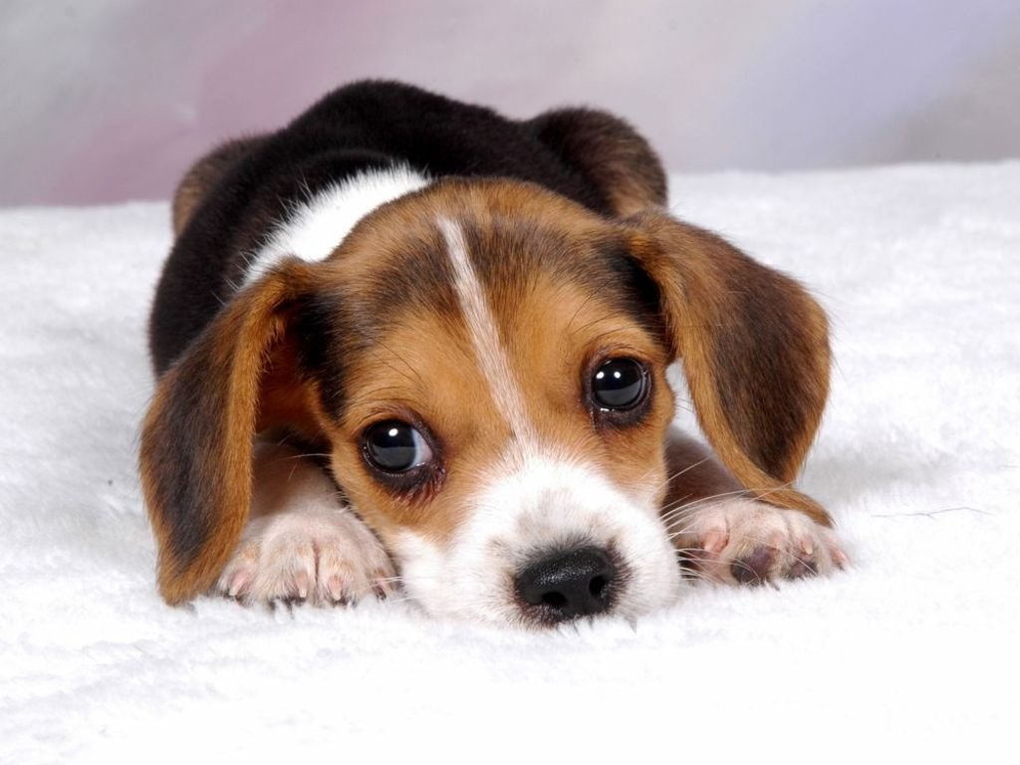
Consequences
you will suffer the consequences!

Slide 16
What are the consequences?
The consequences as set forth by the Board of Education are stated on page 10 of your student handbook.

