Slide 1
The New Republic
International Relations

Slide 2
Vocabulary
mobilization – the act of making troops and supplies ready for war.
alliance – a partnership for mutual benefit and support.
covert – done secretly.
overt – done openly
cede – to give up land, especially through a treaty.
ratification – to formally accept

Slide 3
Background information
American Revolution begins April 1775.
Continental Congress declares independence July 1776.
Continental Army stands alone against the British and hired German troops.
After some initial success, Americans suffer a series of setbacks.
Battles of Saratoga October 1777 – a huge American victory.
As a result, France agrees to an alliance with the US.

Slide 4
Background information
France openly supports the United States against Great Britain.
The Netherlands (Holland) and Spain covertly support the United States.
France, Spain, and The Netherlands all go to war against Great Britain.
The American Revolution becomes a world war.
“The enemy of my enemy is my friend.”

Slide 5
1783 – treaty of paris
The Treaty of Paris ends the American Revolution 1783
The British give up claims to what is called the “Old Northwest Territory.”
Despite the treaty, the British keep military forces in the area until well after the Revolution.
Further, Native Americans resist American expansion into the region.

Slide 6
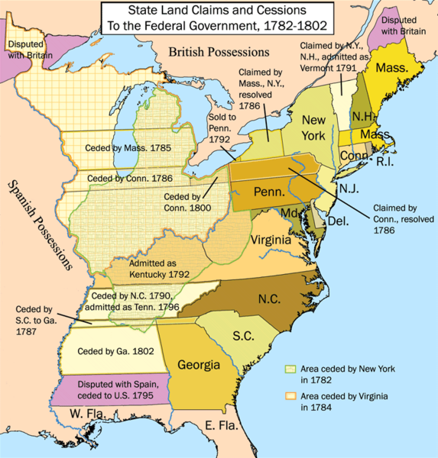
Territorial expansion

Slide 7
The Nation under the articles
By the end of 1783 and early part of 1784 the military and naval forces of the new nation were disbanded.
All of the Continental Navy and Marine Corps ships and men were released from Federal service.
The Army consisted of only 80 men to guard military supplies at West Point and Fort Pitt (Pittsburgh).

Slide 8
Troubles on the frontier
According to the 1783 Treaty the United States was ceded the Northwest Territory.
The British, however maintained their troops in the area for the next 12 years.
The British used the excuse that the United States failed to fulfill the portion of the Treaty that dealt with the US reimbursing Loyalists for their property losses during the war.

Slide 9
Troubles on the frontier
American settlers who pushed in the Northwest territory found that the Native American tribes in the region were hostile and resisted American expansion.

